Slide 1
Amazon Reviews Sentiment Analysis
Andre Graham - 101555540
Younes Bensassi-Nour - 101542854
Adnan Shaikh - 101549676
Yonatan Girma -101532284
Majed Qarmout - 101565483

Slide 2
Table of Contents
Data Analysis
Models performances
Model Variances
Preprocessing pipeline

Slide 3
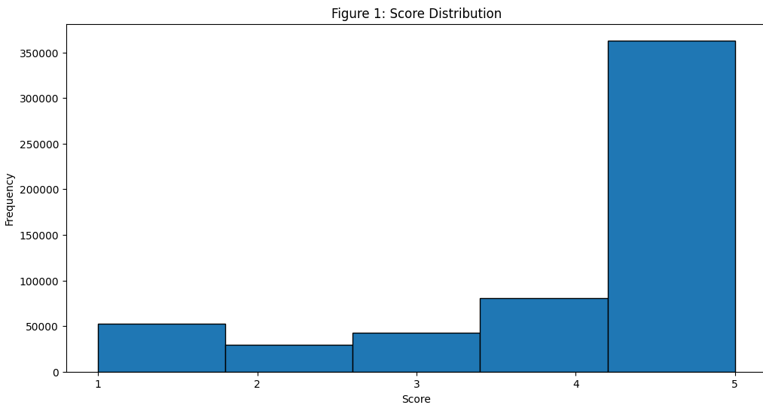
Data Analysis

Slide 4
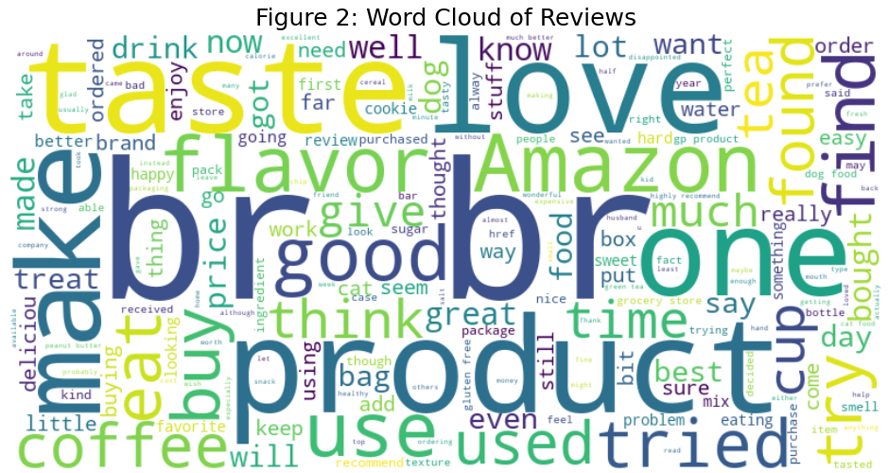
Data Analysis

Slide 5
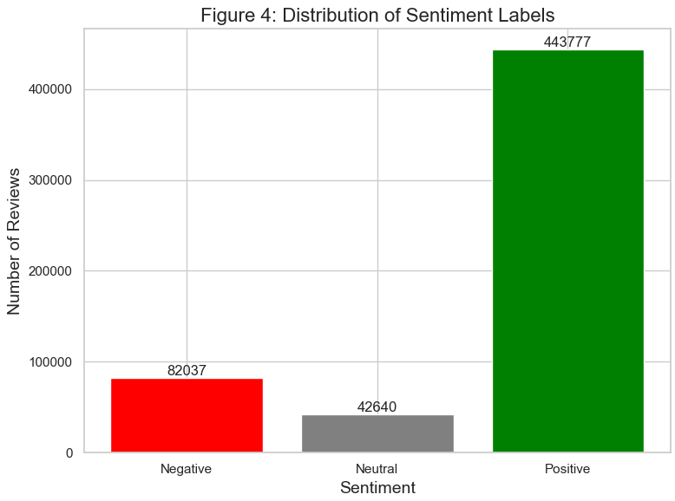
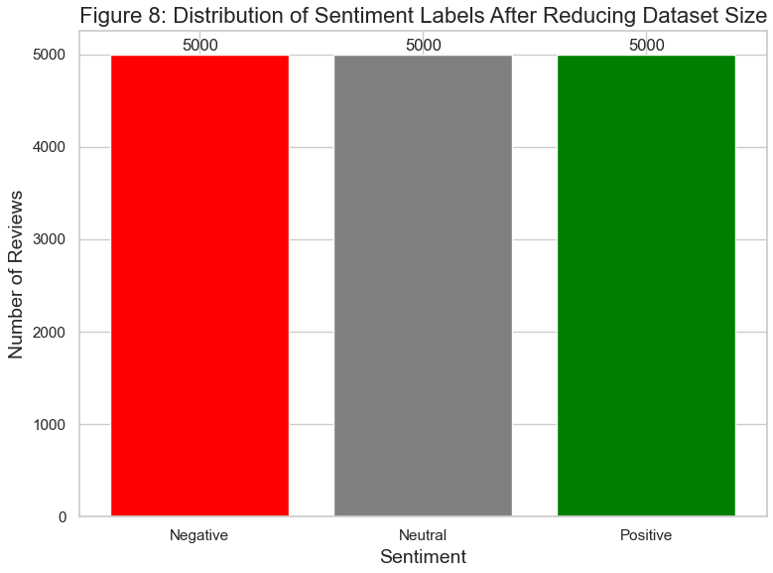
Data Analysis

Slide 6
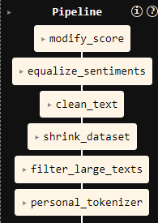
Pre-processing Pipeline
Initial features:
Id
ProductId
UserId
ProfileName
HelpfulnessNumerator
HelpfulnessDenominator
Score
Time
Summary
Text

Slide 7
Models Performances and hyperparameters
Model | Dataset size | # Epochs | Optimizer | Learning Rate | Batch size | Test Accuracy
Distilroberta-base | 15k | 7 | Adam | 2e-5 | 16 | 73%
Roberta-base | 30k | 10 | Adam | 1e-6 | 16 | 77%
Twitter based Roberta base | 127k | 4 | AdamW | 2e-5 | 16 | 85%
LSTM | 120K | 25 | Adam | 0.001 | 120 | 80%

Slide 8
Model Variances
Freezing | The Model | 3 layers
Learning Rate | 1e-5 | 3e-5
Optimizer | Adam | Adamw
Batch size | 16 | 32
Activation Fn | Relu | Tanh
Batch Normalization | True | False
Drop out layers | 0.1 | 0.2

Slide 9
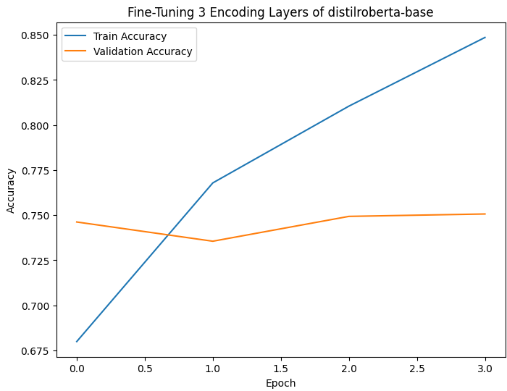
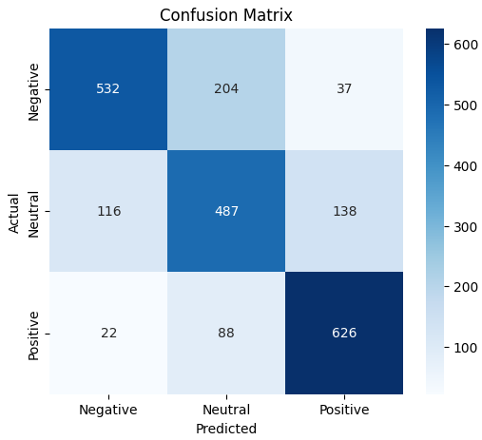
Distilroberta-base

Slide 10
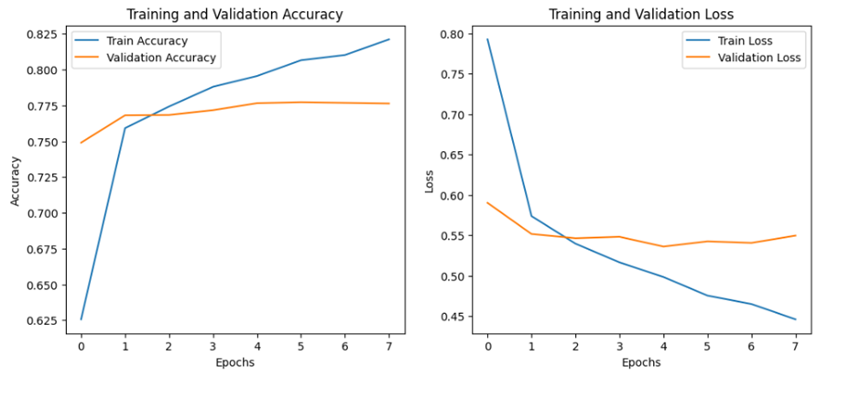
roBERTa-base

Slide 11
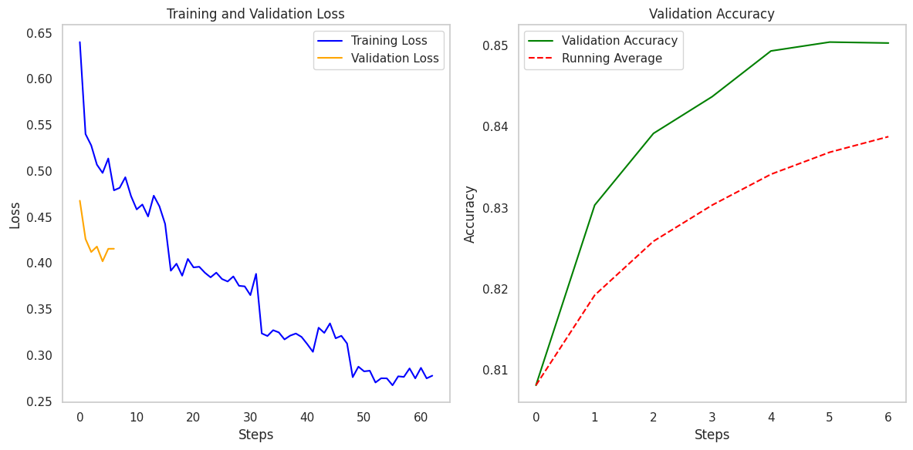
Twitter based Roberta Base

Slide 12
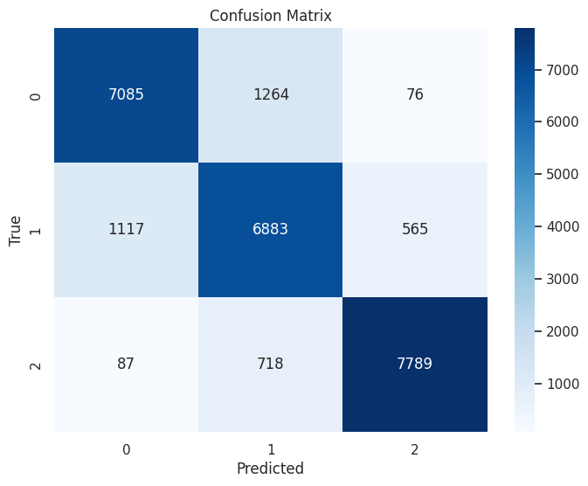
Twitter based Roberta Base
Class 0: Precision: 0.85, Recall: 0.84, F1-Score: 0.85
Class 1: Precision: 0.78, Recall: 0.80, F1-Score: 0.79
Class 2: Precision: 0.92, Recall: 0.91, F1-Score: 0.92

Slide 13
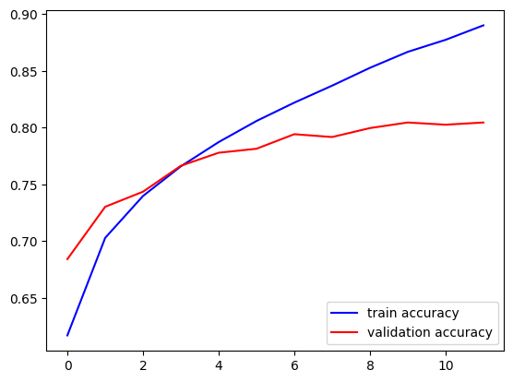
Bidirectional LSTM

